Slide 1



CSEP 590tv: Quantum Computing
Dave Bacon
July 20, 2005
Today’s Menu
Administrivia
Finish Teleportation
Superdense Coding
n Qubit registers
Begin Quantum Algorithms

Slide 2
Administrivia
Turn in HW #3. It was meant to be harder than HWs #1 and #2.
Was it?
Pick up HW #4. It should be easier than HW #3.
HW#2 solutions available on website
Here is my goal:
“Difficulty”
#1
#2
#3
#4
#5
#6
Final

Slide 3
Administrivia
July 20: multi qubit registers, begin quantum algorithms
July 27: quantum algorithms
Aug 3: quantum entanglement
Aug 10: quantum error correction
Aug 17: post-final lecture on ???

Slide 4
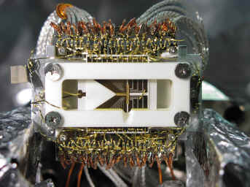
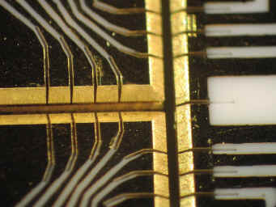
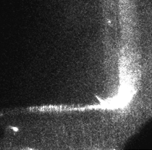
Shuttling Around a Corner
Pictures snatched from Chris Monroe’s
University of Michigan website

Slide 5
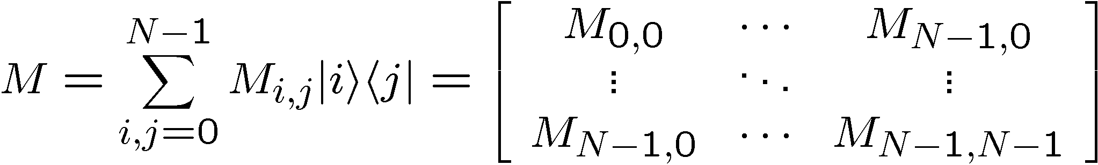



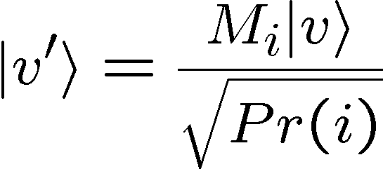

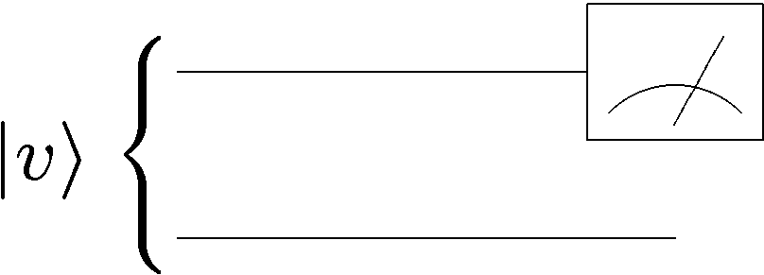



Recap
Matrices in outer product notation
Projectors:
Measurement operators:
Probability of outcome i:
New state if outcome is i:
Measuring first of two qubits. Measurement operators:

Slide 6
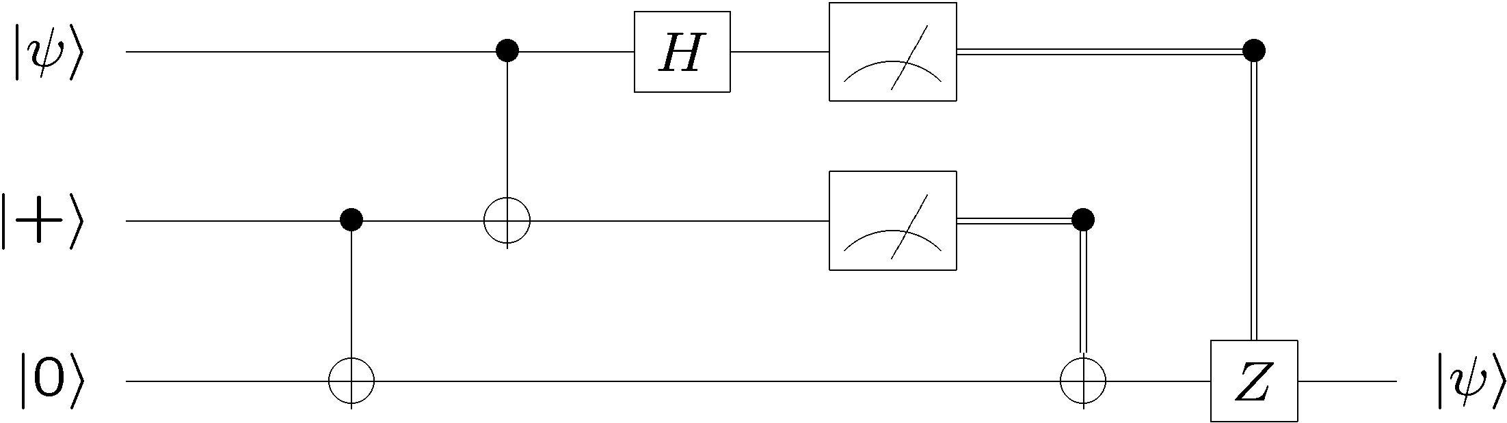
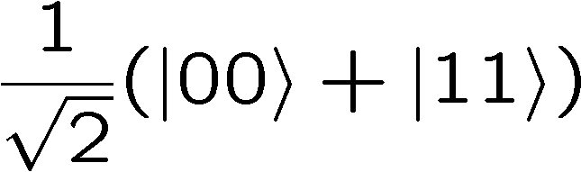
Recap
Deutsch’s problem.
Distinguishing between constant and balanced.
2 classical queries
1 quantum query
Quantum teleportation:
Bell basis measurement
Alice
50 % 0, 50 % 1
50 % 0, 50 % 1
Bob

Slide 7
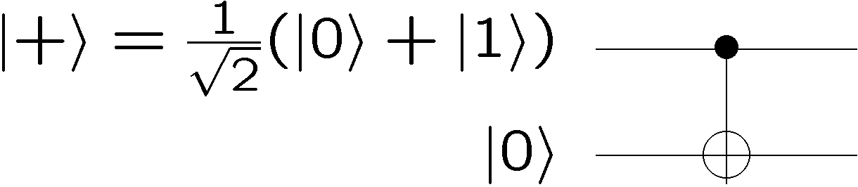
Teleportation
Bell basis measurement
Alice
50 % 0, 50 % 1
50 % 0, 50 % 1
Bob
First step is that Alice and Bob should share the entangled state:

Slide 8

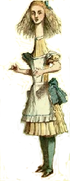
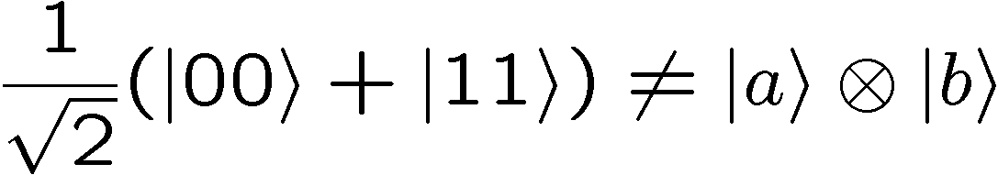
Teleportation
two qubits
2. Separate
1. Interact and
entangle
BOB
ALICE
Alice and Bob each have a qubit, and the wave function of their two qubit is entangled. This means that we can’t think of Alice’s
qubit as having a particular wave function. We have to talk about the “global” two qubit wave function.

Slide 9

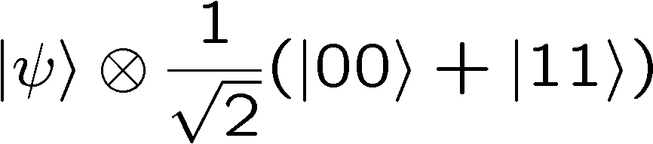
Teleportation
ALICE
BOB
Alice does not know the wave function
We have three qubits whose wave function is
qubit 1
qubit 2 and qubit 3

Slide 10
Separable, Entangled, 3 Qubits
If we consider qubit 1 as one subsystem and qubits 2 and 3 as
another subsystem, then the state is separable across this divide
However, if we consider qubits 1 and 2 as one system and qubits 3 as one subsystem, then the state is entangled across this divide.
1
2
3
1
2
3
seperable
entangled

Slide 11
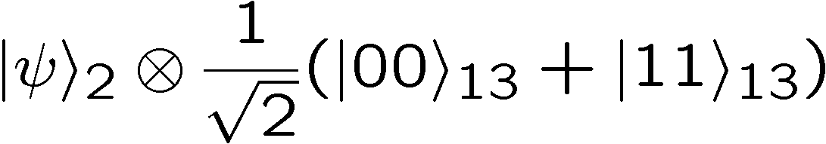
Separable, Entangled, 3 Qubits
Sometimes we will deal with entangled states across
non adjacent qubits:
How do we even “write” this?
Subscript denotes which qubit(s) you are talking about.

Slide 12
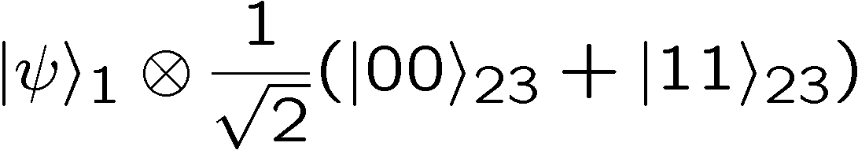
Separable, Entangled, 3 Qubits
1
2
3
1
2
3

Slide 13
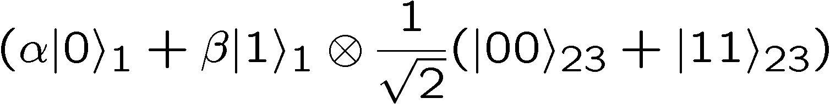
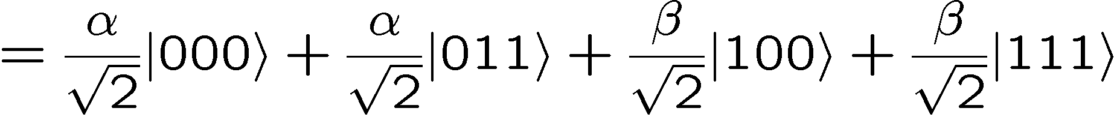
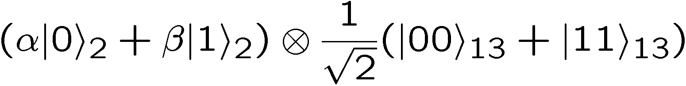
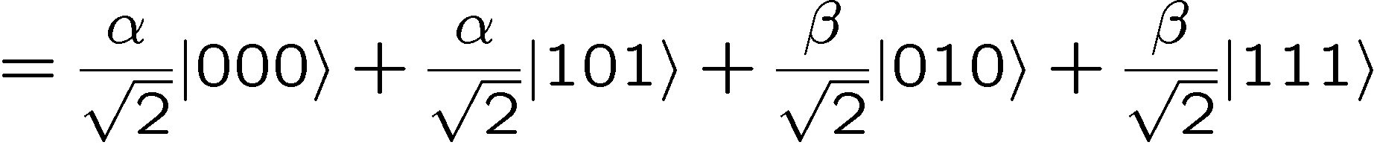
Separable, Entangled, 3 Qubits
When we don’t write subscripts we mean “standard ordering”

Slide 14
Teleportation
ALICE
BOB
Alice does not know the wave function
We have three qubits whose wave function is
qubit 1
qubit 2 and qubit 3

Slide 15
Teleportation
Bell basis measurement
Alice
50 % 0, 50 % 1
50 % 0, 50 % 1
Bob

Slide 16
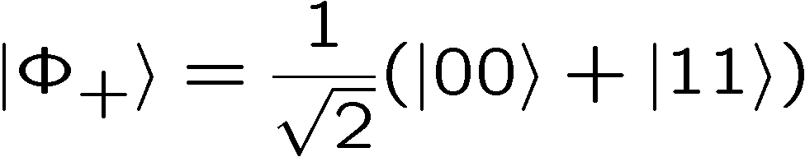
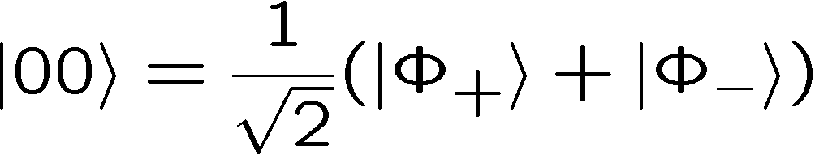
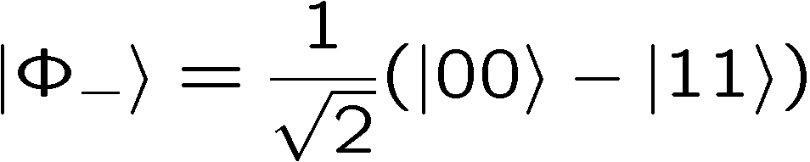
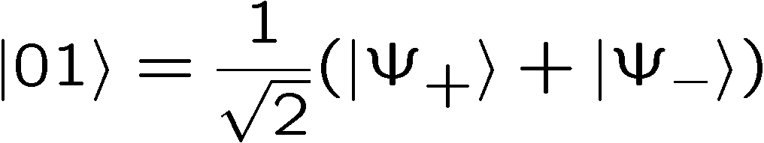
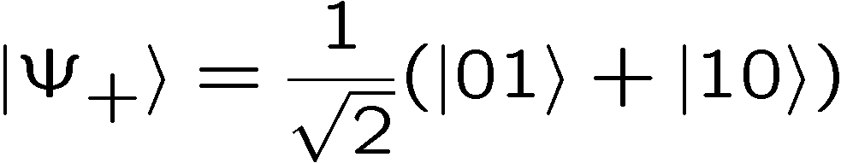
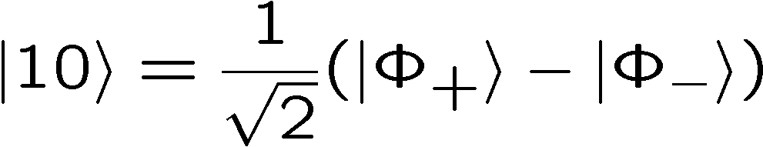
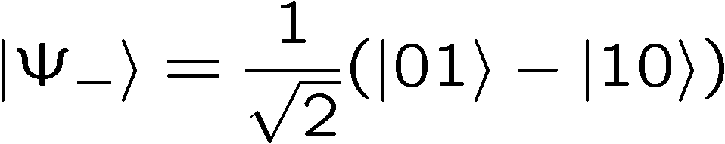
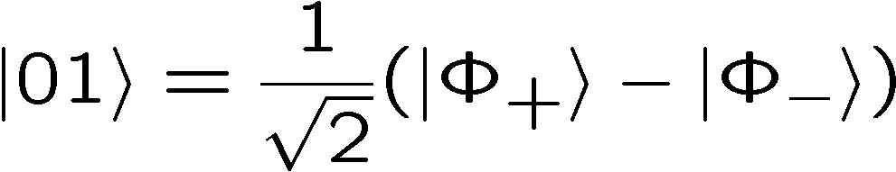
Teleportation
Express this state in terms of Bell basis for first two qubits.
Bell basis
Computational basis

Slide 17
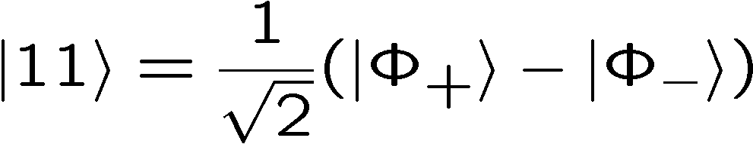
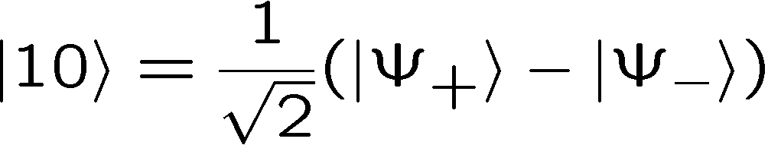
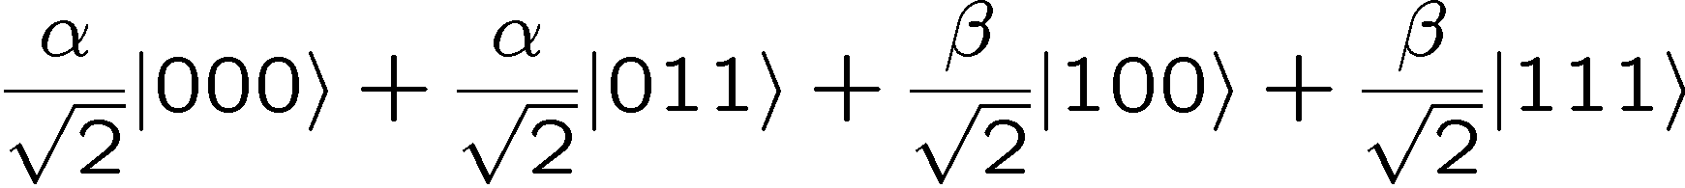
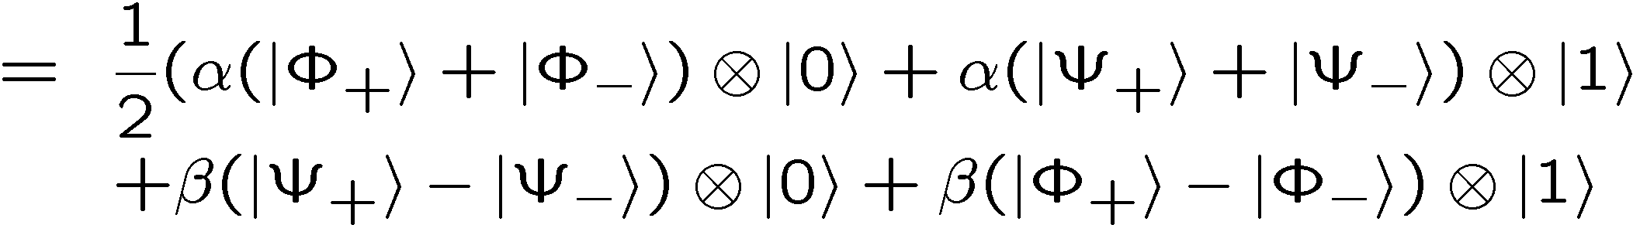
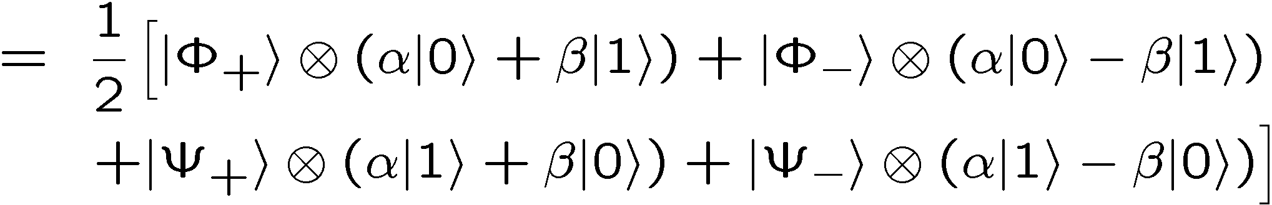
Teleportation
Bell basis
Computational basis

Slide 18
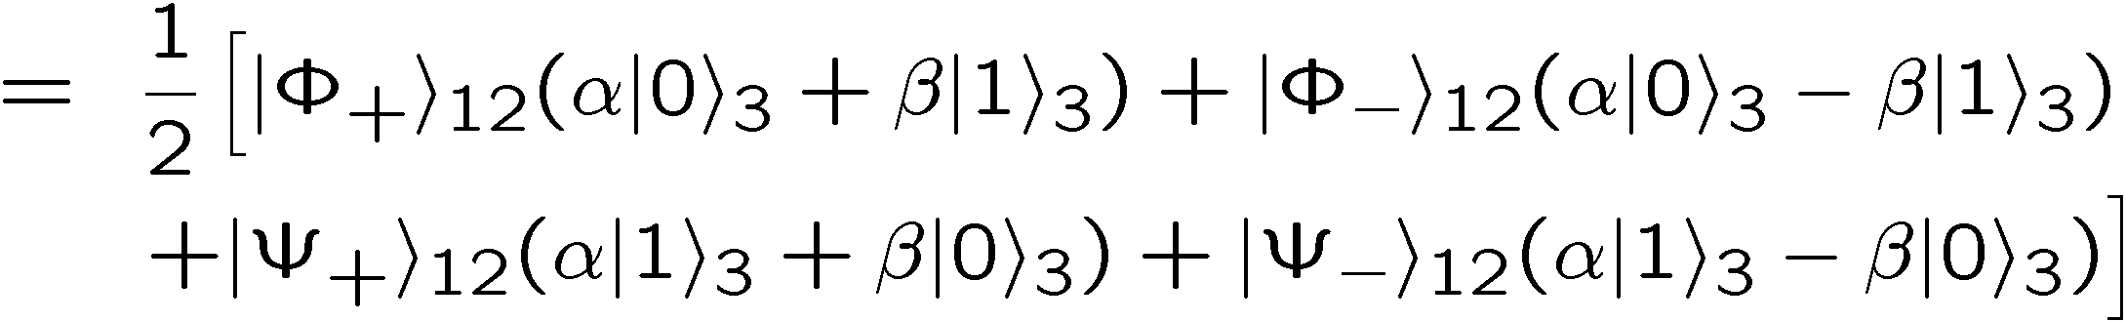
Teleportation
Bell basis measurement
Alice
50 % 0, 50 % 1
50 % 0, 50 % 1
Bob

Slide 19
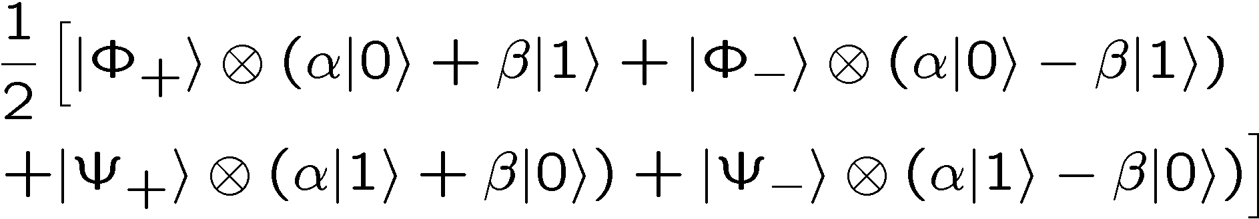
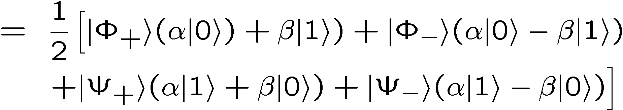
Dropping The Tensor Symbol
Sometimes we will just “drop” the tensor symbol.
“Context” lets us know that there is an implicit tensor product.

Slide 20
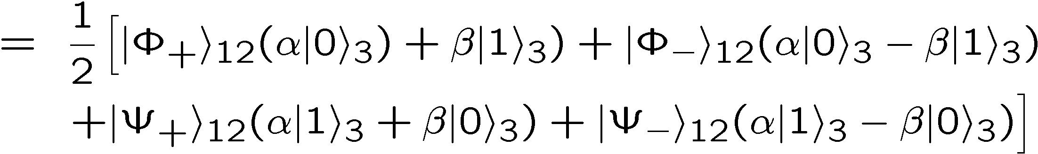
Teleportation
Bell basis measurement
Alice
50 % 0, 50 % 1
50 % 0, 50 % 1
Bob

Slide 21
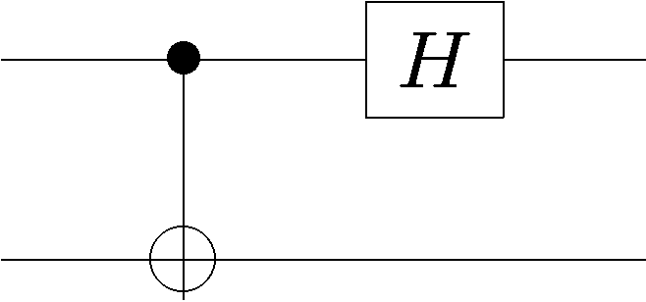
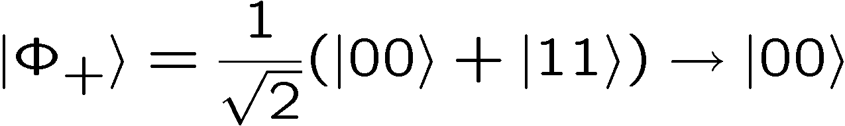
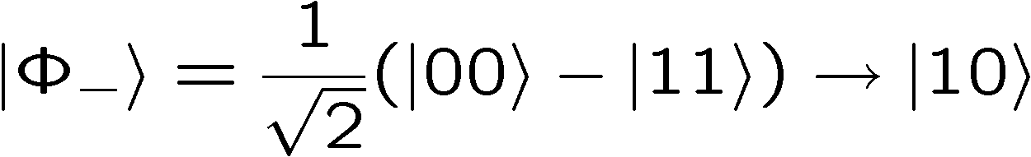
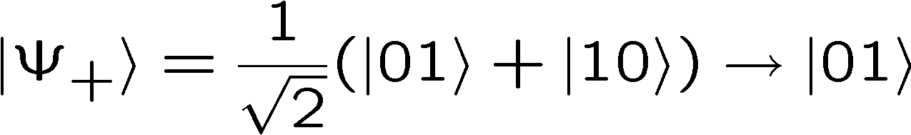
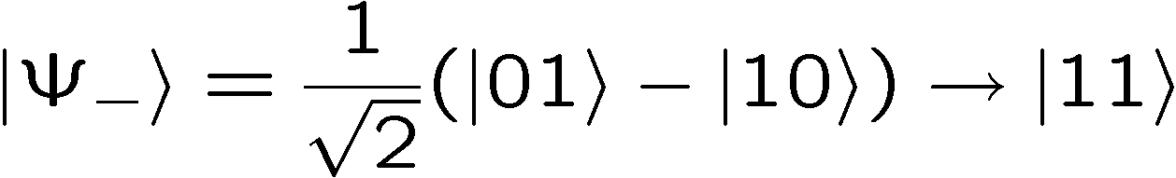
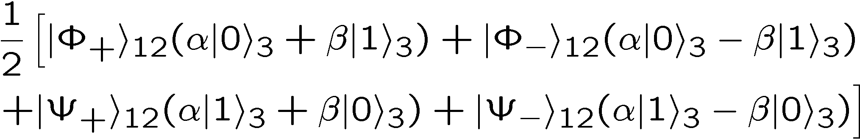
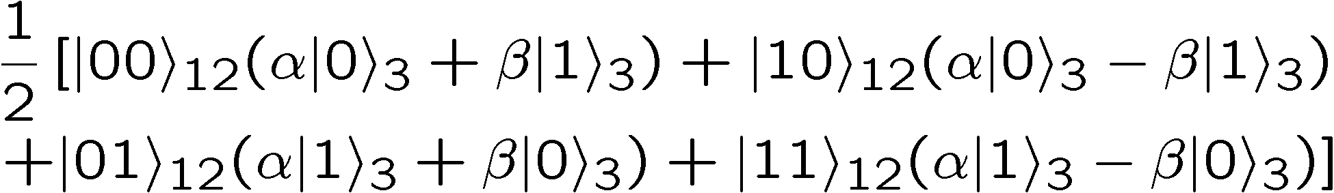
Bell Basis Measurement

Slide 22
Teleportation
Bell basis measurement
Alice
50 % 0, 50 % 1
50 % 0, 50 % 1
Bob

Slide 23




Teleportation
Given the wave function
Measure the first two qubits in the computational basis
Equal ¼ probability for all four outcomes and new states are:

Slide 24
Teleportation
Bell basis measurement
Alice
50 % 0, 50 % 1
50 % 0, 50 % 1
Bob

Slide 25



Teleportation
If the bits sent from Alice to Bob are 00, do nothing
If the bits sent from Alice to Bob are 01, apply a bit flip
If the bits sent from Alice to Bob are 10, apply a phase flip
If the bits sent from Alice to Bob are 11, apply a bit & phase flip

Slide 26
Teleportation
Bell basis measurement
Alice
50 % 0, 50 % 1
50 % 0, 50 % 1
Bob

Slide 27






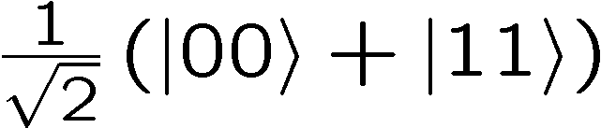
Teleportation
Alice
Bob
Alice
Bob

Slide 28
Teleportation
1 qubit = 1 ebit + 2 bits
Teleportation says we can replace transmitting a qubit
with a shared entangled pair of qubits plus two bits of
classical communication.
Superdense Coding
Next we will see that
2 bits = 1 qubit + 1 ebit

Slide 29




Superdense Coding
Suppose Alice and Bob each have one qubit and the joint
two qubit wave function is the entangled state
Alice wants to send two bits to Bob. Call these bits and .
Alice applies the following operator to her qubit:
Alice then sends her qubit to Bob.
note:
Bob then measures in the Bell basis to determine the two bits
2 bits = 1 qubit + 1 ebit

Slide 30
In Class Problem 1

Slide 31
Bell Basis
The four Bell states can be turned into each other using
operations on only one of the qubits:

Slide 32
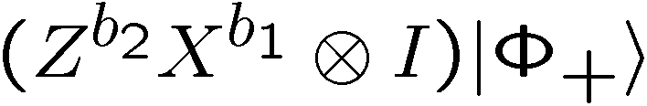








Superdense Coding
Initially:
Alice applies the following operator to her qubit:
Bob can uniquely determine which of the four states he has
and thus figure out Alice’s two bits!

Slide 33
Superdense Coding
Bell basis
measurement

Slide 34
Teleportation
1 qubit = 1 ebit + 2 bits
Teleportation says we can replace transmitting a qubit
with a shared entangled pair of qubits plus two bits of
classical communication.
Superdense Coding
2 bits = 1 qubit + 1 ebit
We can send two bits of classical information if we share an entangled state and can communicate one qubit of quantum information:

Slide 35
Quantum Algorithms

Slide 36
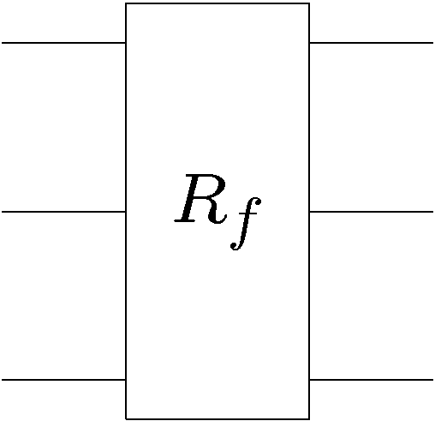





Classical Promise Problem
Query Complexity
Given: A black box which computes some function
k bit input
k bit output
black box
Promise: the function belongs to a set which is a subset
of all possible functions.
Properties: the set can be divided into disjoint subsets
Problem: What is the minimal number of times we have to
use (query) the black box in order to determine which subset
the function belongs to?

Slide 37
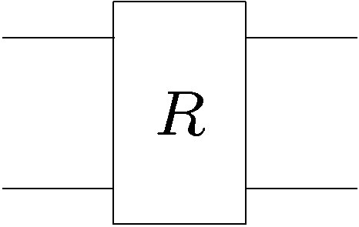










Example
Suppose you are given a black box which computes one of
the following four reversible classical gates:
2 bits input
2 bits output
controlled-NOT
+ NOT 2nd bit
“identity”
NOT 2nd bit
controlled-NOT
Deutsch’s (Classical) Problem: What is the minimal number of times we have to use this black box to determine whether we are given one of the first two or the second two functions?

Slide 38
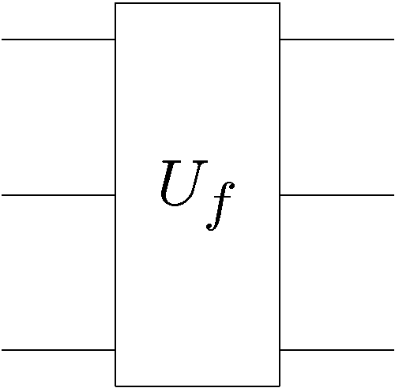


Quantum Promise Query Complexity
Given: A quantum gate which, when used as a classical device
computes a reversible function
k qubit input
k qubit output
black box
Promise: the function belongs to a set which is a subset
of all possible functions.
Properties: the set can be divided into disjoint subsets
Problem: What is the minimal number of times we have to
use (query) the quantum gate in order to determine which
subset the function belongs to?

Slide 39



n Qubit Registers
Up until now, we have dealt with only 1,2,3, or 4 qubits.
Now we will deal with n qubits at a time!
n qubits
Computational basis:
n bit string

Slide 40

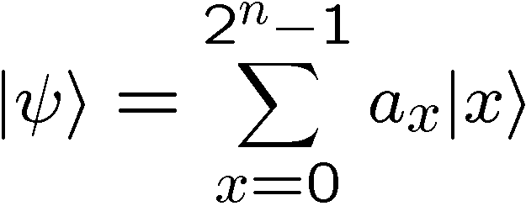

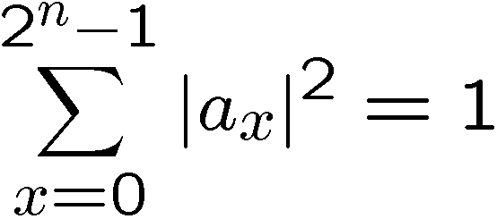
n Qubit States
n qubits have a wave function with complex numbers.
Writing complex numbers down, and keeping track of them
(in a naïve manner) is very computationally inefficient.
This is one of the first indications that simulating a quantum
computer on a classical computer might be very difficult.
are complex numbers
properly normalized:

Slide 41
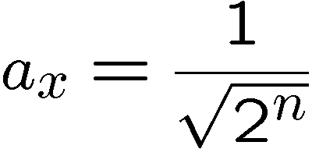




n Qubit States
Example:
properly normalized:
Notice how compact this 1st notation is.

Slide 42


n Qubit Hadamard
Hadamard all n qubits
n qubits
input
n qubits
output

Slide 43



n Qubit Hadamard
Hadamard one qubit in computational basis:
Hadamard n qubits in computational basis:

Slide 44



n Qubit Hadamard
Addition can be done modulo 2 (turns plus to exclusive-or)
Again notice compactness of
notation.

Slide 45



Superposition Over All
If we start in the zero bitstring, then Hadmarding all n qubits
creates a superposition over all possible bitstrings:

Slide 46




Superposition Over All
Hadamarding the superposition over all states:

Slide 47




Superposition Over All

Slide 48



Superposition Over All
Could have found in easier fashion using

Slide 49

From Comp. Basis to Matrix
From the effect of the Hadamard on the computational basis
We can deduce the form of the matrix in outer product form:

Slide 50

Hadamard Basis Elements
Recall that the columns of a matrix form a basis.
What is this basis for the Hadamard?
The basis elements for the Hadmard are:

Slide 51




Hadamard Basis Elements
Check orthonormality:

Slide 52


Hadamard Basis Elements

Slide 53
In Class Problem 2

